Slide 1
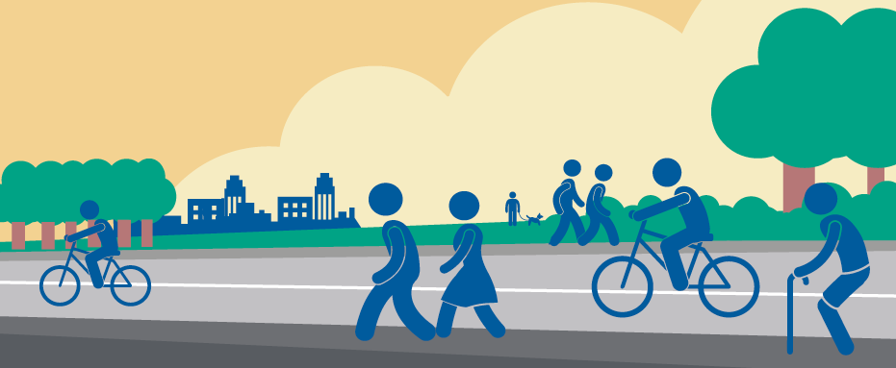
Armagh City, Banbridge and Craigavon
Borough Council
Active Travel Masterplan
October 2021

Slide 2
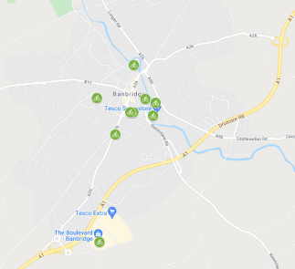
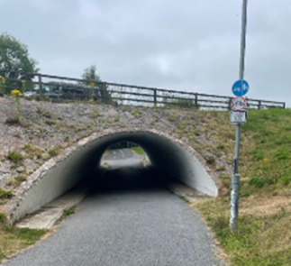
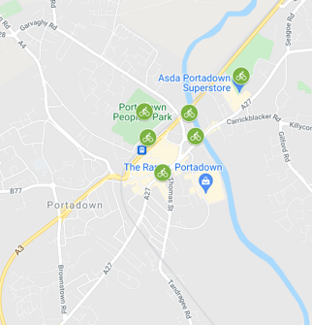
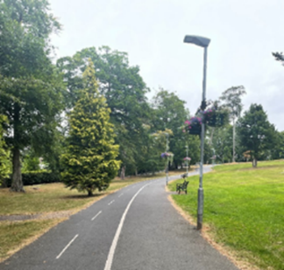
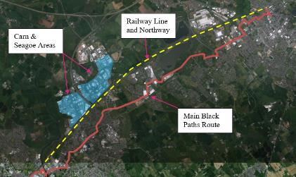
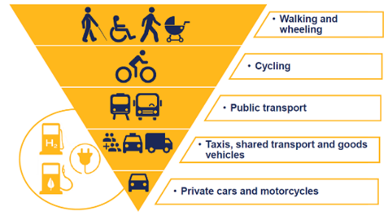
Active Travel Masterplan - Scope
Active Travel
Existing Town Cycle Parking Audits
Review of current Active Travel Policies and Cycle Guidance
Connections to the Carn and Seagoe Industrial Estates
Black Paths Walkover and Route Review

Slide 3
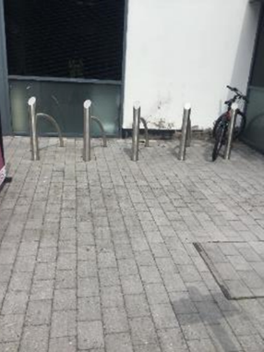
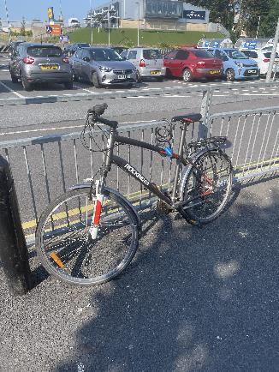
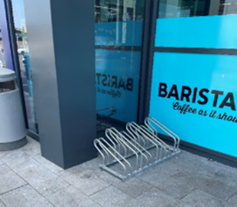
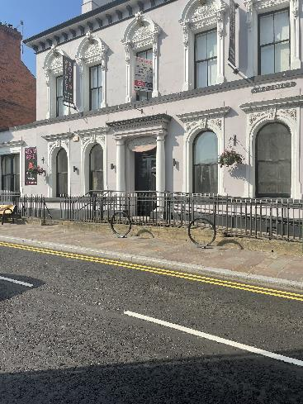
Town Centre Cycle Parking
Overview
Site Visits to record the volume and quality of existing cycle parking in:-
Armagh City
Banbridge
Craigavon
Dromore
Lurgan
Portadown
Key findings:-
Cycle parking facilities within the six towns exist but usage is generally very low, and a large proportion is located on private land for customer use.
Design of the existing facilities is varied with little consistency. Multiple cyclists observed to park their bicycles by chaining them to railings rather than existing facilities.
Two sites were at capacity, located at Rushmere Shopping Centre in Craigavon and Lurgan Train Station

Slide 4
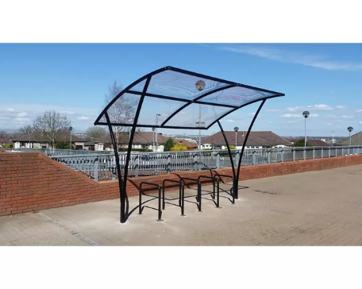
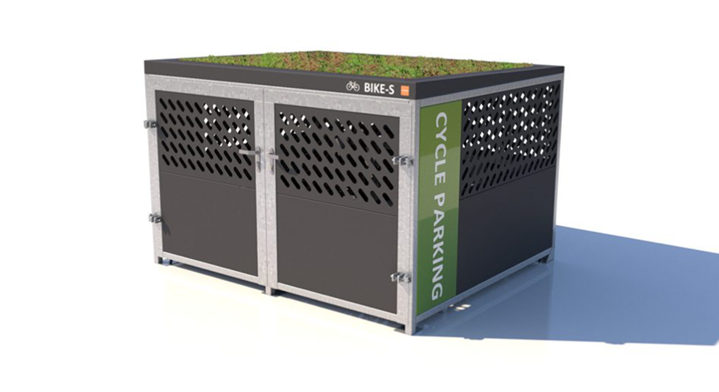
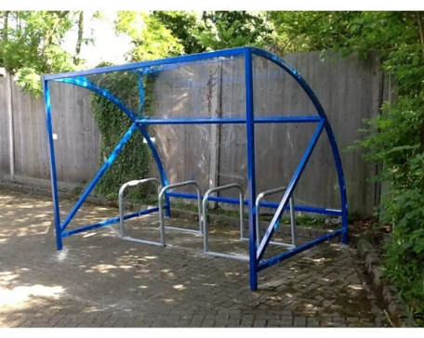
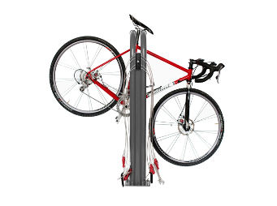
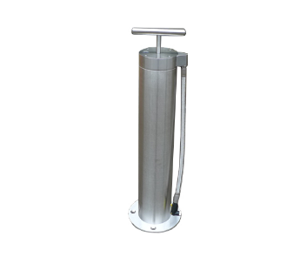
Town Centre Cycle Parking
Types of Intervention
For each town a range of potential cycle parking solutions considered:-
Secure cycle store units
Typical Sheffield Stands
Generic covers or ‘New York’ style
E-bike Charging Points
Cycle Maintenance Stands and Pumps
A ‘hierarchy’ of locations considered, with council offices/ leisure centres receiving a higher level of cycle parking given the visibility and security of the locations, followed by off street car parks, parks and then within the existing footways of the town centres.
Generally uncovered Sheffield Stands considered suitable for parks/ footways given the associated cost of maintenance and potential vandalism.

Slide 5
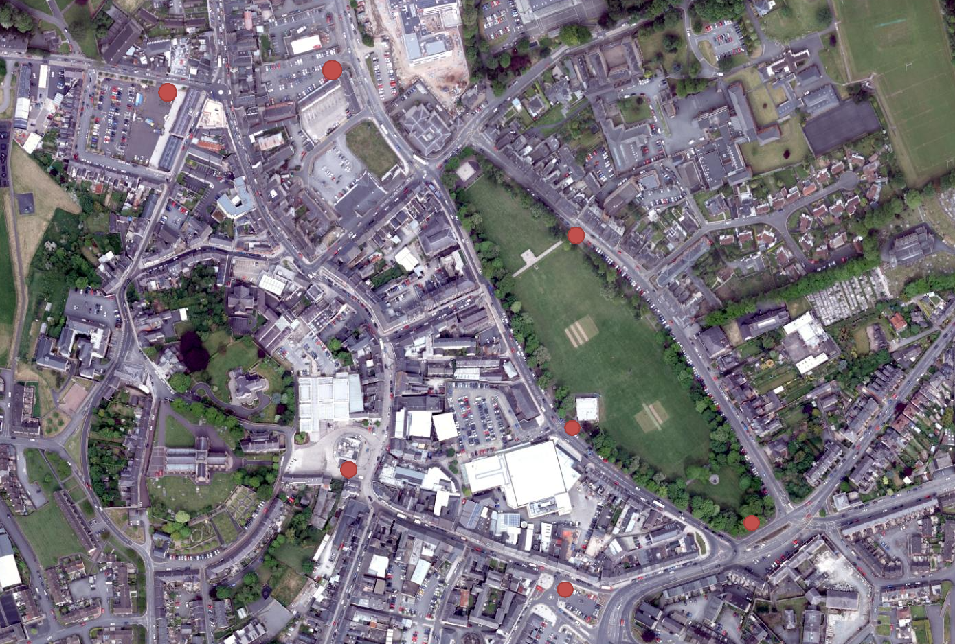
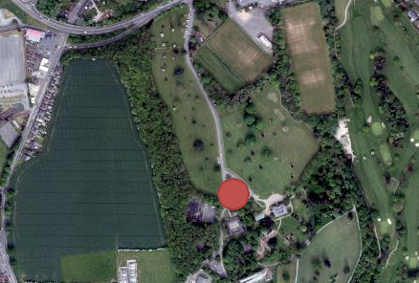
Armagh City Cycle Parking
Key Areas
1 | Palace Demesne | Cycle Shelter
 |  | Cycle Shelter
 |  | Ebike Rack
 |  | Cycle Pump Unit
2 | The Mall (South) | Sheffield Stand 5
 |  | Cycle Pump Unit
 |  | Ebike Rack
3 | The Mall (East) | Sheffield Stand 5
4 | The Mall (West) | Sheffield Stand 5
5 | Market Street | Sheffield Stand 5
 |  | Cycle Pump Unit
6 | Shambles Market | 10 Sheffield Stands
7 | Scotch Street Car Park | Sheffield Stand 5
8 | Lonsdale St Car Park | 10 Sheffield Stands
8
6
3
4
5
2
1
7

Slide 6
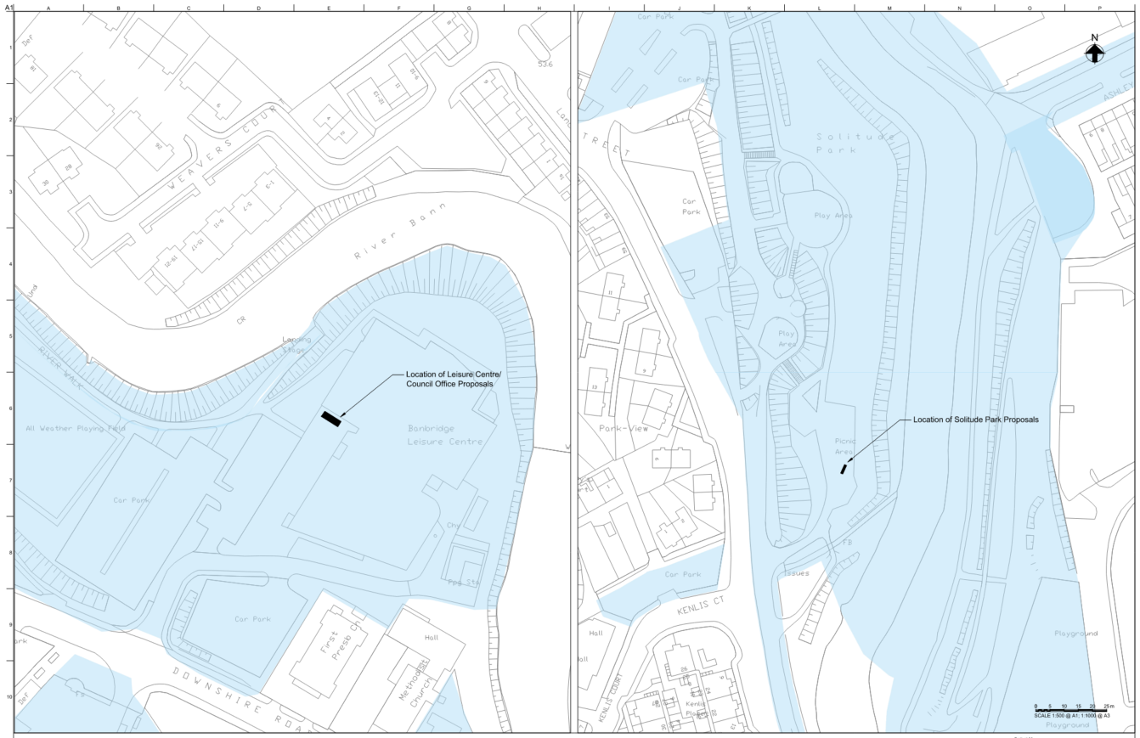
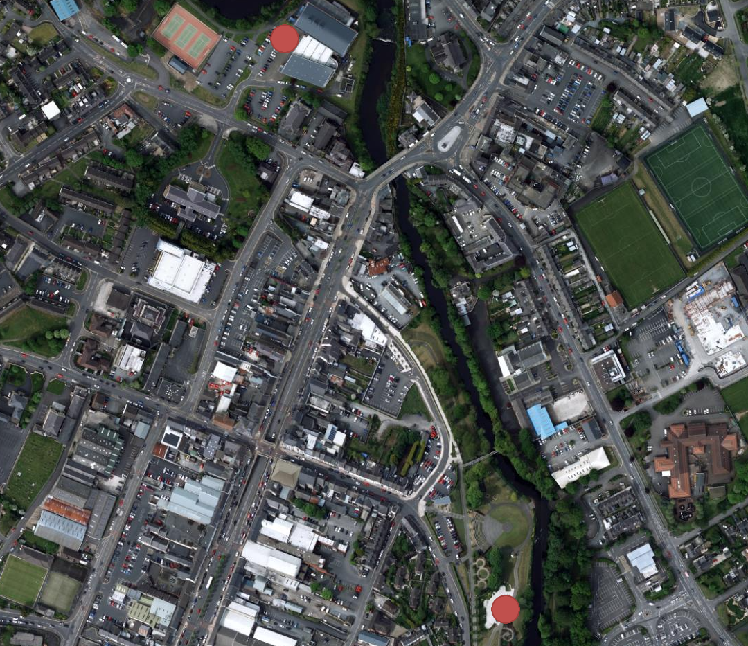
Banbridge Cycle Parking
Key Areas
1 | Leisure Centre/ Council Offices | Cycle Shelter
 |  | Cycle Shelter
 |  | Ebike Rack
 |  | Cycle Pump Unit
2 | Solitude Park | 5 Sheffield Stands
1
4
2

Slide 7
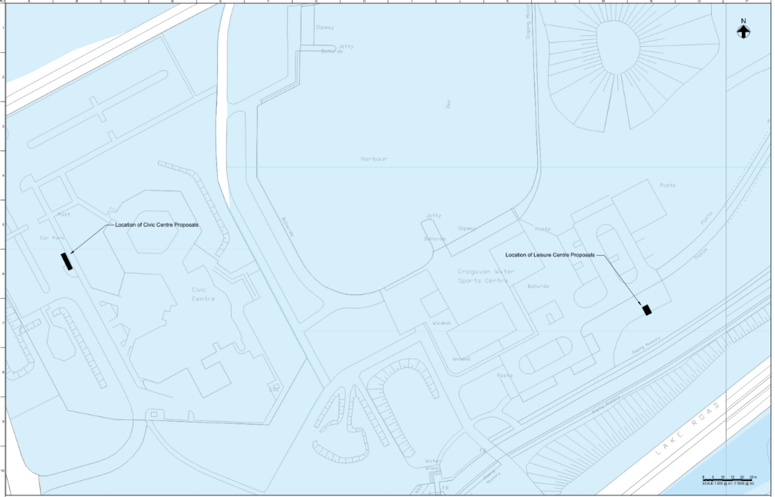
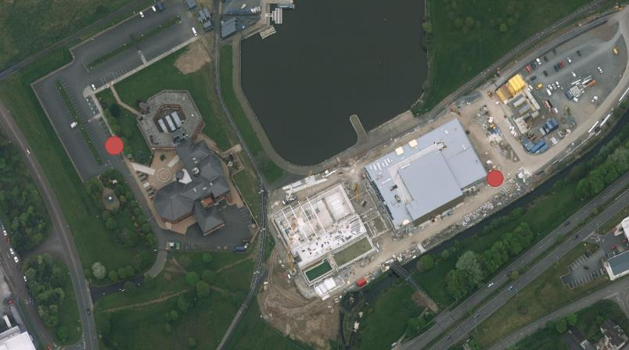
Craigavon Cycle Parking
Key Areas
1 | Craigavon Civic Centre | BDS 8 Space Cycle Shelter
 |  | BDS 6 Space Cycle Shelter
 |  | Ebike Rack
 |  | Cycle Pump Unit
 |  | Cycle Repair Stand
2 | South Lake Leisure Centre | BDS 6 Space Cycle Shelter
 |  | Ebike Rack
 |  | Cycle Pump Unit
 |  | Cycle Repair Stand
1
2

Slide 8
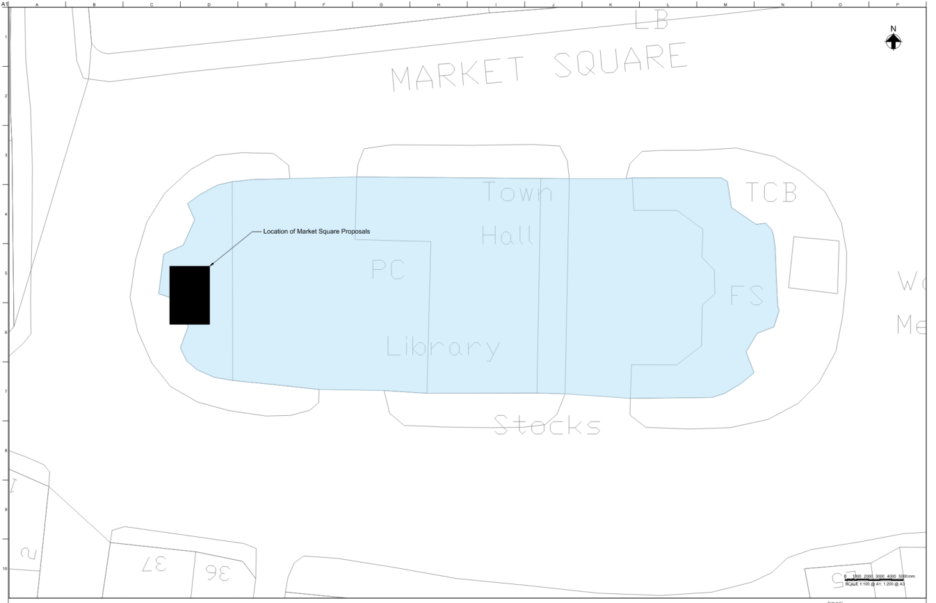
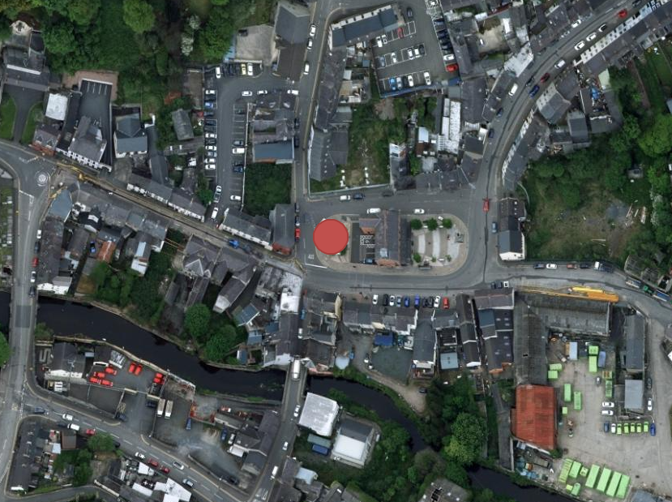
Dromore Cycle Parking
Key Areas
1 | Market Square | Secure Cycle Storage Unit
 |  | Cycle Pump Unit
 |  | Cycle Repair Stand
1
1
2

Slide 9
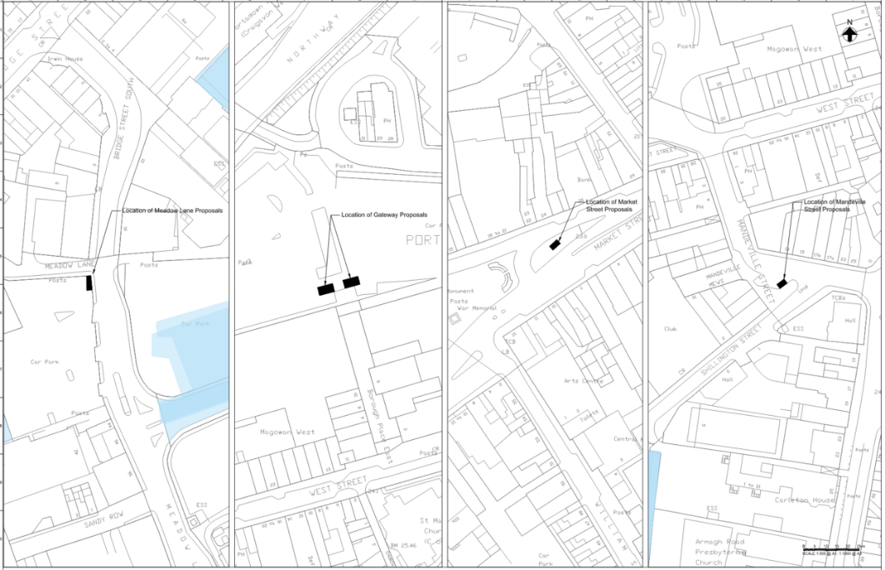
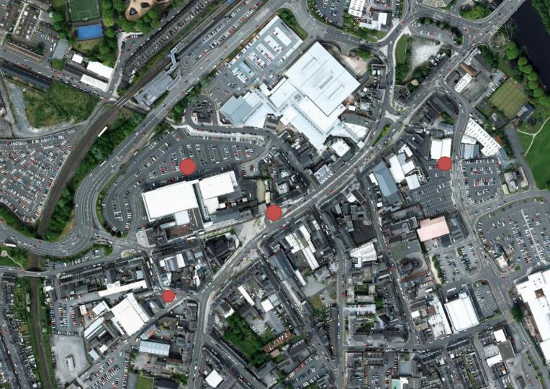
Portadown Cycle Parking
Key Areas
1 | Meadow Lane West Car Park | 10 Sheffield Stands
2 | Market Street (bottom section of Plaza) | 5 Sheffield Stands
3 | Magowan West Car Park | 6 Sheffield Stands
 |  | Ebike Rack
4 | Mandeville Street | 5 Sheffield Stands
3
1
2
4

Slide 10
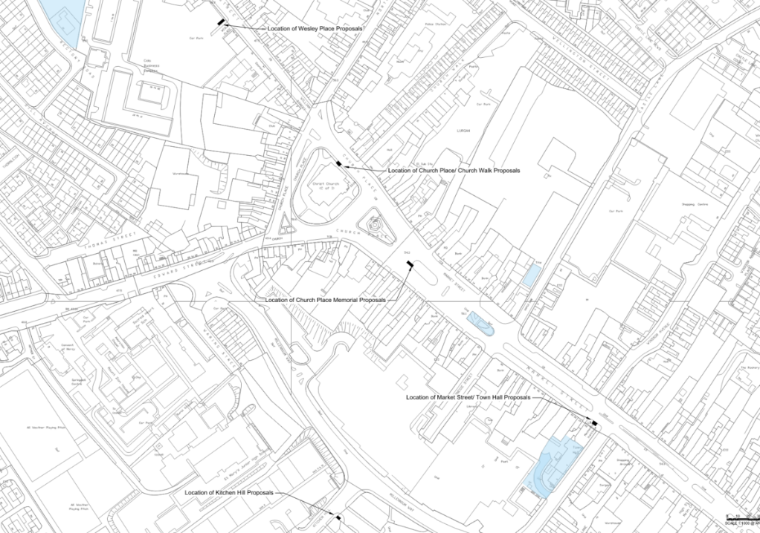
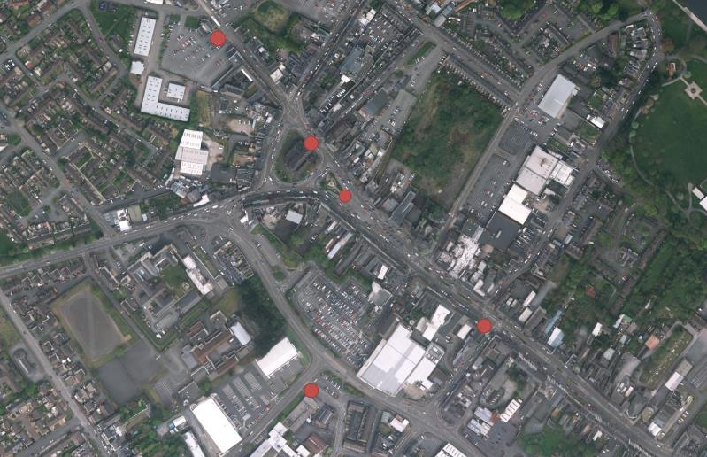
Lurgan Cycle Parking
Key Areas
1 | Wesley Place Car Park | 5 Sheffield Stands
2 | Church Place (Adjacent to Church Walk) | 5 Sheffield Stands
3 | Church Place (Adjacent to Memorial/ Public Realm) | 5 Sheffield Stands
4 | Kitchen Hill/ Upper Bann Institute | 5 Sheffield Stands
5 | Market Street/ Town Hall | 5 Sheffield Stands
1
2
3
5
4

Slide 11
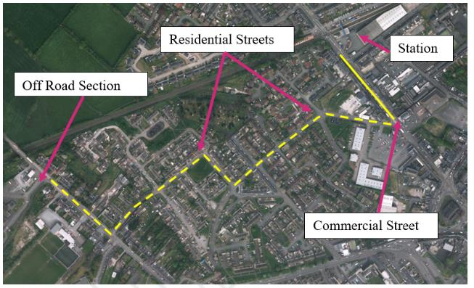
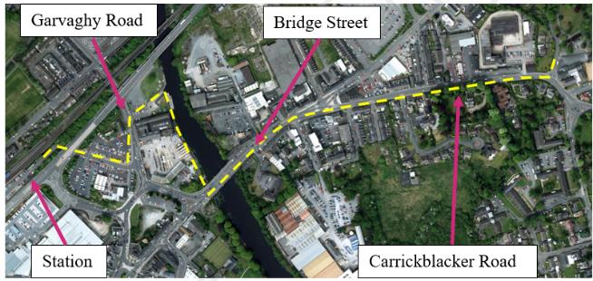
Black Paths
Overview
The Black Paths Greenway is of a high quality, given its recent investment, but with some points requiring some maintenance.
Connection from St Francis Primary to Lurgan Rail Station generally of good quality but lacks coherent wayfinding signage.
Connection from Eden Villa Park to Portadown Rail Station constrained by mixed facilities and interfaces with commercial streets/ A27 high volume traffic route.
A review of wayfinding found evidence of frequent directional signage along the route, but some were obstructed by foliage, defaced with graffiti, and failed to include the destination, distance, or route number.
Gaps in signage provision were also noted along the route, most notably between Portadown Train Station and beginning of the greenway at Eden Villa Park and around the North Lake.

Slide 12
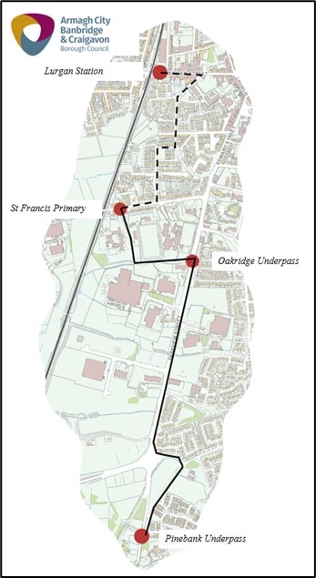
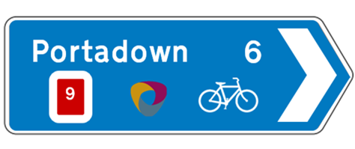
Black Paths – Lurgan Connections to Railway & South Lake Leisure Centre
Lurgan Station
Silverwood Drive, Prospect Way and Charles Street all represent a ‘Quiet Street’ environment, providing a natural link between William Street and Francis Street/ Black Paths.
William Street shared surface facilities on northern side remain.
Providing wayfinding ‘totems’ at key locations will give users advanced notice of the route and can be enhanced by additional simple directional signage.
Indicative Directional Sign
Indicative Totem Sign

Slide 13
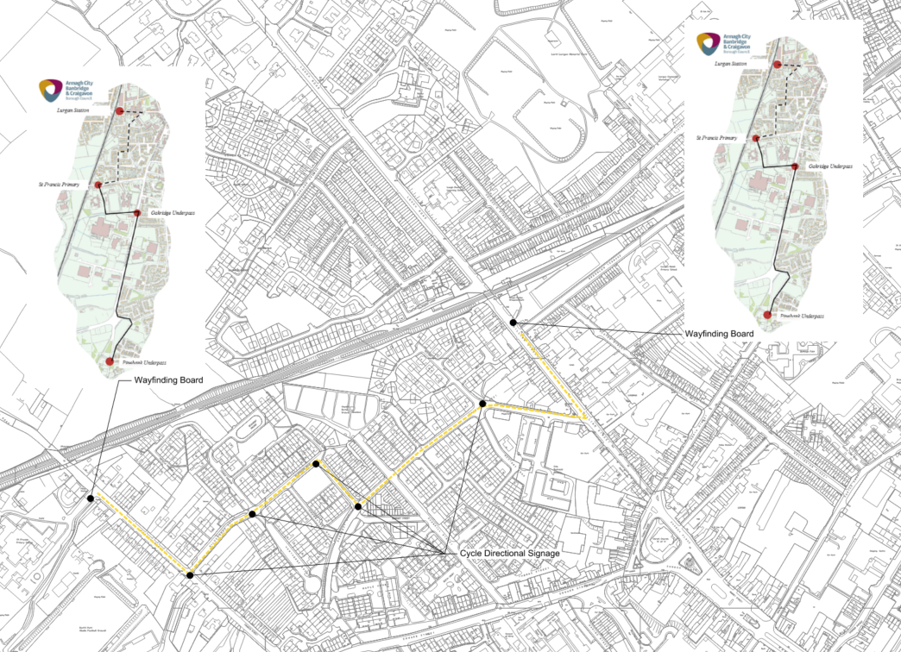
Black Paths – Lurgan Connections to Railway & South Lake Leisure Centre
Sign Locations
St Francis Primary School
Francis Street/ Silverwood Drive Junction
Silverwood Drive/ Hawthorne Avenue/ Cyprus Gardens Junction
Silverwood Drive/ Oakfield Terrace Junction
Oakfield Terrace/ Prospect Way Junction
Charles Street/ Rectory Road Junction
Lurgan Rail Station

Slide 14
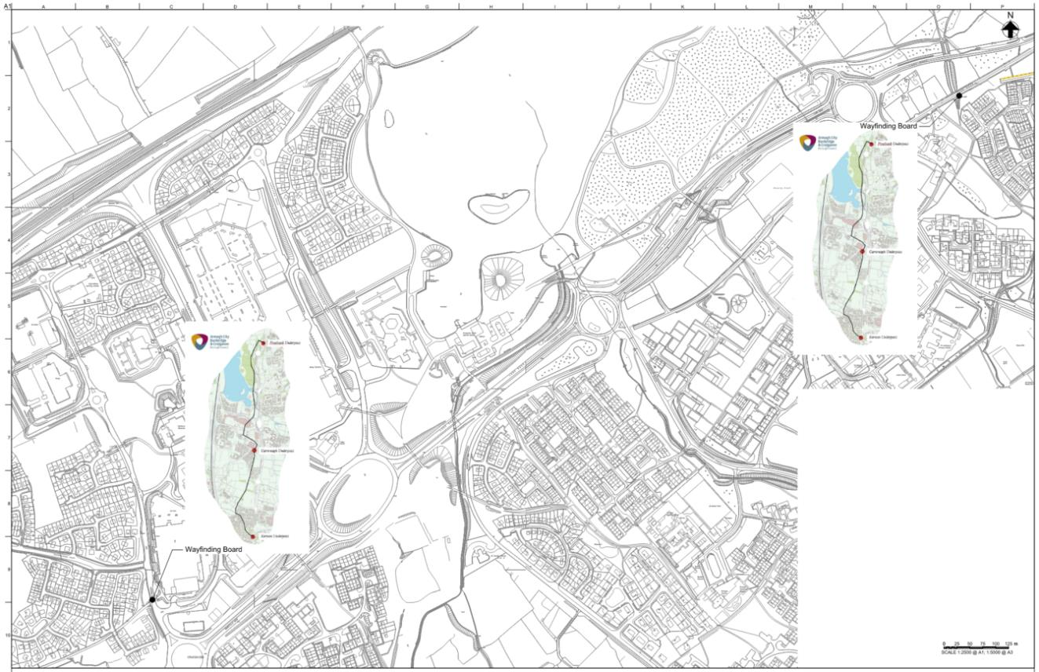
Black Paths – South Lake Leisure Centre
Sign Locations
Pinebank Underpass (either side)
Carnreagh Underpass (either side)
Kernan Underpass (either side)
Option to enhance totems with clear indication of South Lake Leisure Centre Location
Section benefits from recent investment, resurfacing and directional sign refresh

Slide 15
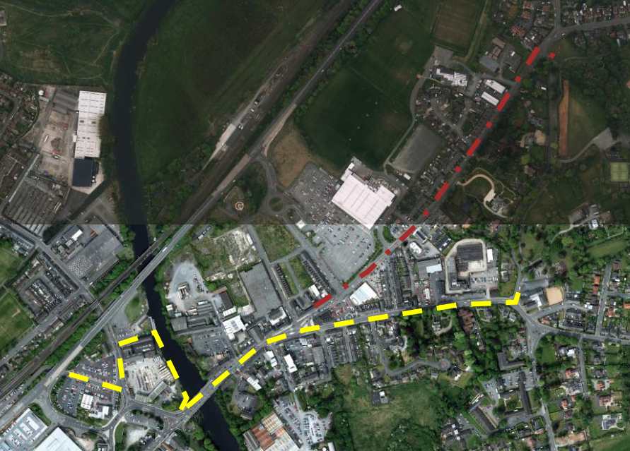
Black Paths – Portadown Connections to Railway & South Lake Leisure Centre
Portadown Station
A potential solution to improve the cycling environment on Carrickblacker Road through extend the footway width into the area currently occupied by the advisory lanes.
Seagoe Road provides alternate route but is steeper, higher traffic volumes and suffers from the same blockages of advisory cycle lane
Provision of a signalised pedestrian crossing point on the Garvaghy Road would offer a safe facility for cyclists and pedestrians to gain access to/ from the rail station.
Again, providing wayfinding ‘totems’ at key locations will give users advanced notice of the route and can be enhanced by additional simple directional signage.

Slide 16
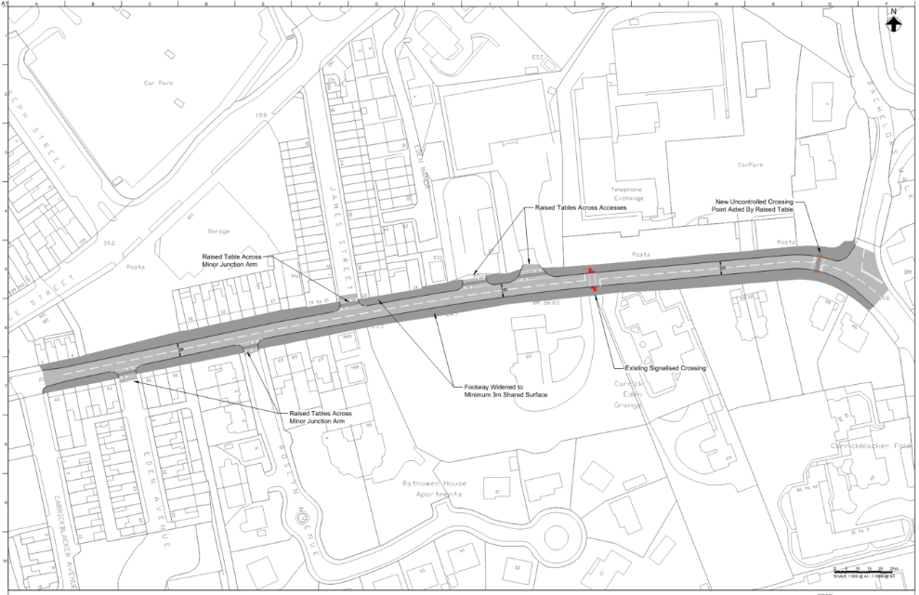
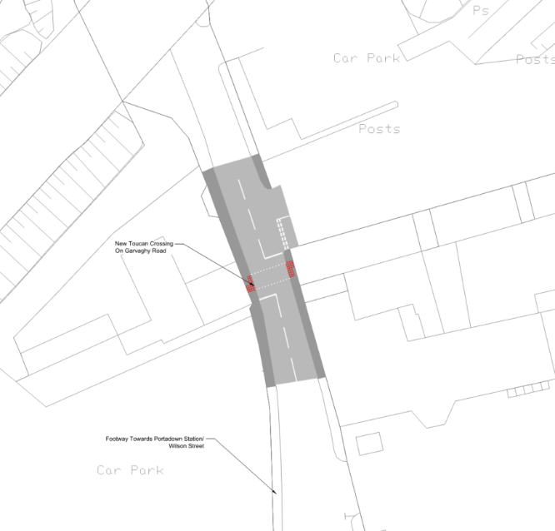
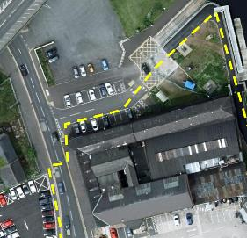
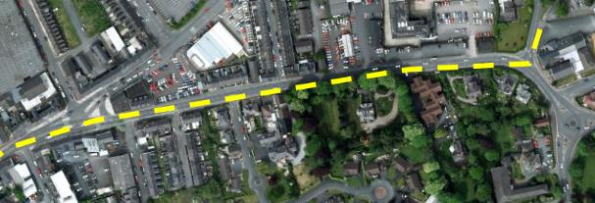
Black Paths – Portadown Connections to Railway & South Lake Leisure Centre
Portadown Station – Physical Interventions
Carrickblacker Road
Garvaghy Road

Slide 17
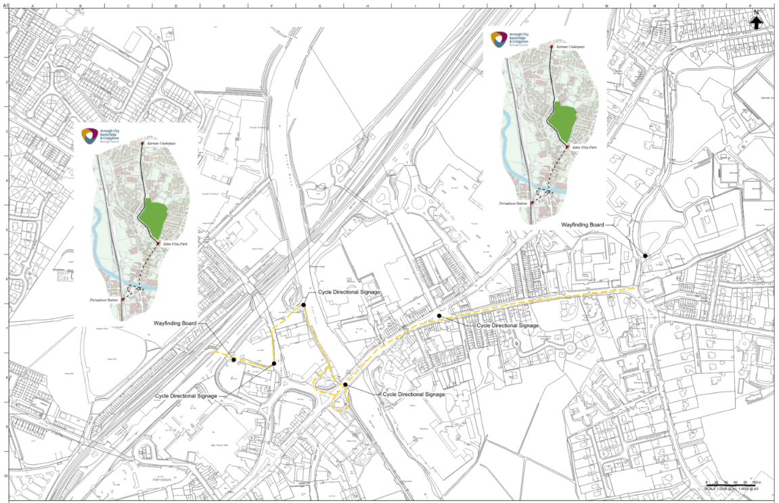
Black Paths – Portadown Connections to Railway & South Lake Leisure Centre
Portadown Station – Sign locations
Wilson Street adjacent to underpass
Wilson Street/ Castle Street junction
River Bann Boat Jetty
Bridge Street (North side footway)
Bridge Street / Carrickblacker Road junction central island
Bachelors Walk/ Eden Villa Park Entrance

Slide 18
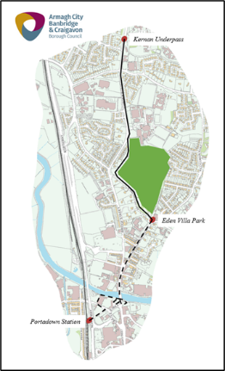
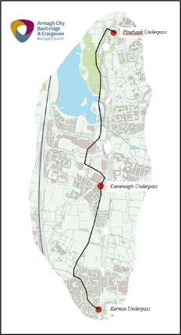
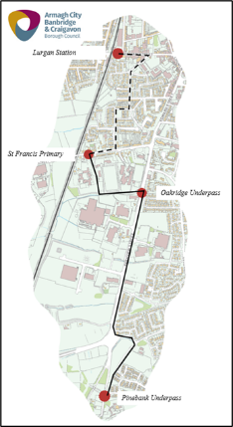
Black Paths – Connections to Rail and Wayfinding
Wayfinding – Key Recommendations
A series of wayfinding maps be position at key decision points along the route;
Additional directional signage, particularly between Portadown Station and Eden Villa Park, and Lurgan Station and Francis Street Primary;
Consideration to including the ACBC logo or similar branding to the signage, to improve the sense of place and ownership;
Consider including a level of cycle parking directional signs within the town centres; and
Consider including wayfinding maps at specific town centre locations to advise of the facilities and amenities in the area.

Slide 19
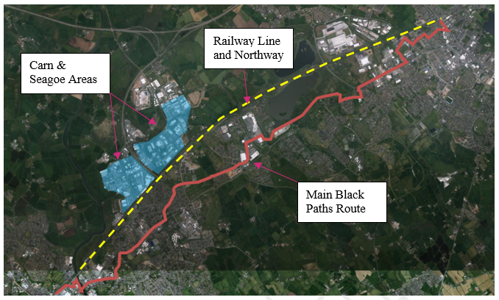
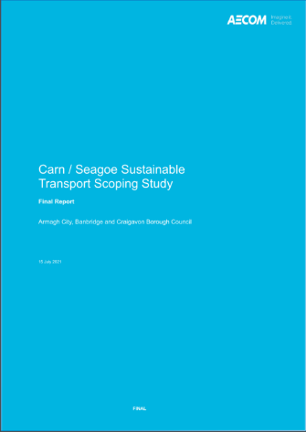
Black Paths – Carn and Seagoe
Connection Issues
Carn and Seagoe areas remain segregated from these facilities, with the limited links a detractor to the businesses in the area that wish to reduce their carbon footprint through promoting active travel for staff.
The Local Development Plan Preparatory Studies (2015) report has highlighted this issue, with a potential solution to improve the Drumnagood Road underpass.
Northway, the Railway line and the numerous commercial and residential areas limit connection points.
AECOM recommendations for the area focus on modal shift through car sharing/ public transport improvements but note enhancement of walking and cycling should be considered.

Slide 20
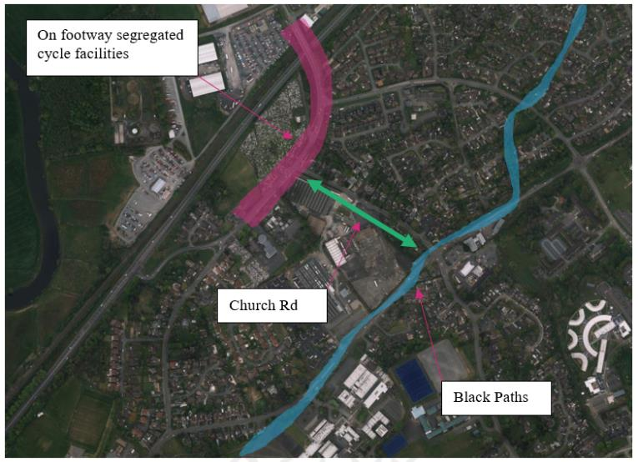
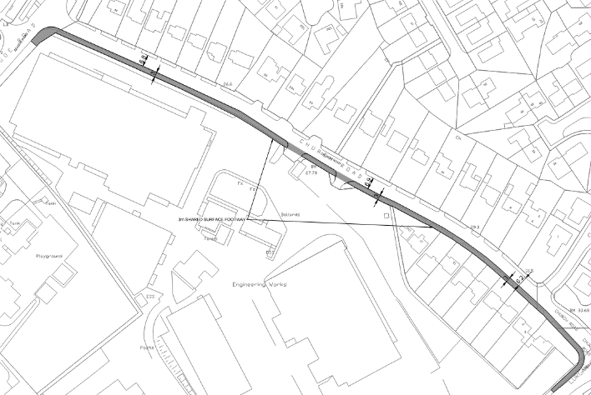
Black Paths – Carn and Seagoe
Seagoe Connections
Northway bridge and Seagoe Road currently provide a good level of cycle connectivity through on-footway segregated cycle lanes.
Key issue is linking the Black Paths to Seagoe Road
Opportunity exists to widen footway on Church Road
Provides a shared surface facility for both pedestrians and cyclists to connect from Lurgan Road to Seagoe Road.

Slide 21
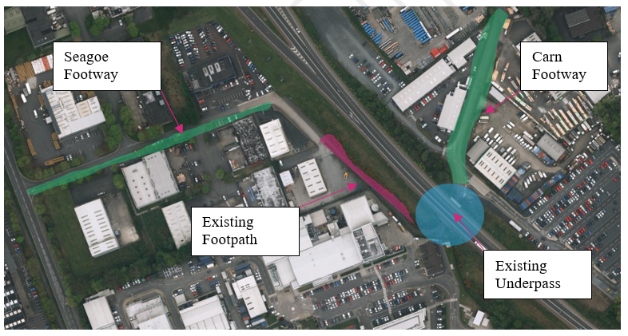
Black Paths – Carn and Seagoe
Linking Carn and Seagoe
The basic infrastructure is present to provide a suitable link, with improvement measures similar to those that have been undertaken at the various other underpasses on the Black Paths.
Both sides of the underpass are linked via a narrow footway and adjacent access road, with required improvements likely to include:-
Improving the width and surfacing of the pathway;
Improving the underpass;
Providing additional street lighting along the connection; and
Formalising the connections to footways to prevent parking.

Slide 22
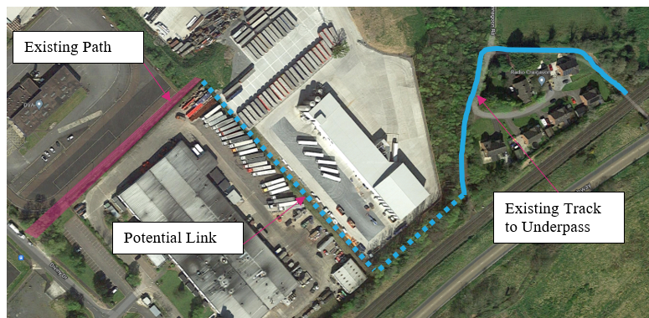
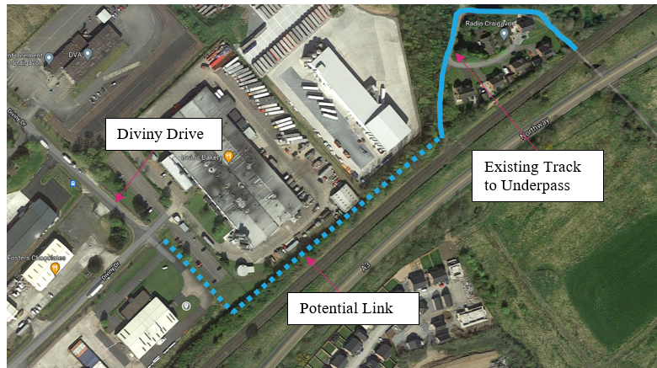
Black Paths – Carn and Seagoe
Linking Carn to Underpass
Existing underpass to east of Carn
Connecting to underpass will require liaising with third party land owners
Two options:-
Between Bakery Buildings
Diviny Drive – Kestrel Foods Linkage
Diviny Drive – Kestrel Foods link considered to be the more preferable solution given its better visibility and potential reduced third party land issues.

Slide 23
Black Paths – Carn and Seagoe
Linking Carn Underpass to Black Paths
The existing underpass requires improvements in terms of surfacing, lighting and visibility.
The connecting footpath between the underpass and Drumnagoon Road requires formal surfacing and the inclusion of street lighting.
The Drumnagoon Road can be easily upgraded to a formal 3m shared surface continuing to the junction with Carnreagh.
The Carnreagh residential development is naturally suited to be a ‘cyclable street’ and appropriate wayfinding signage will provide an excellent link into the main Black Paths route

Slide 24
We Shape a Better World
www.arup.com

